Slide 1
Web portal for campus management of different records Throught block chain
BY:-19IT036
:-19IT029

Slide 2
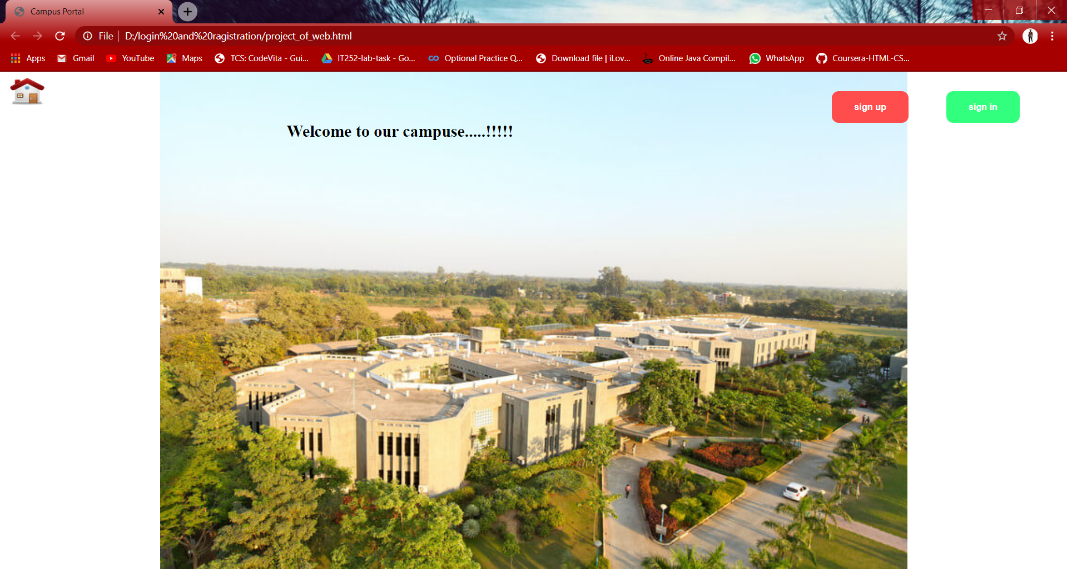
HOME PAGE:-

Slide 3
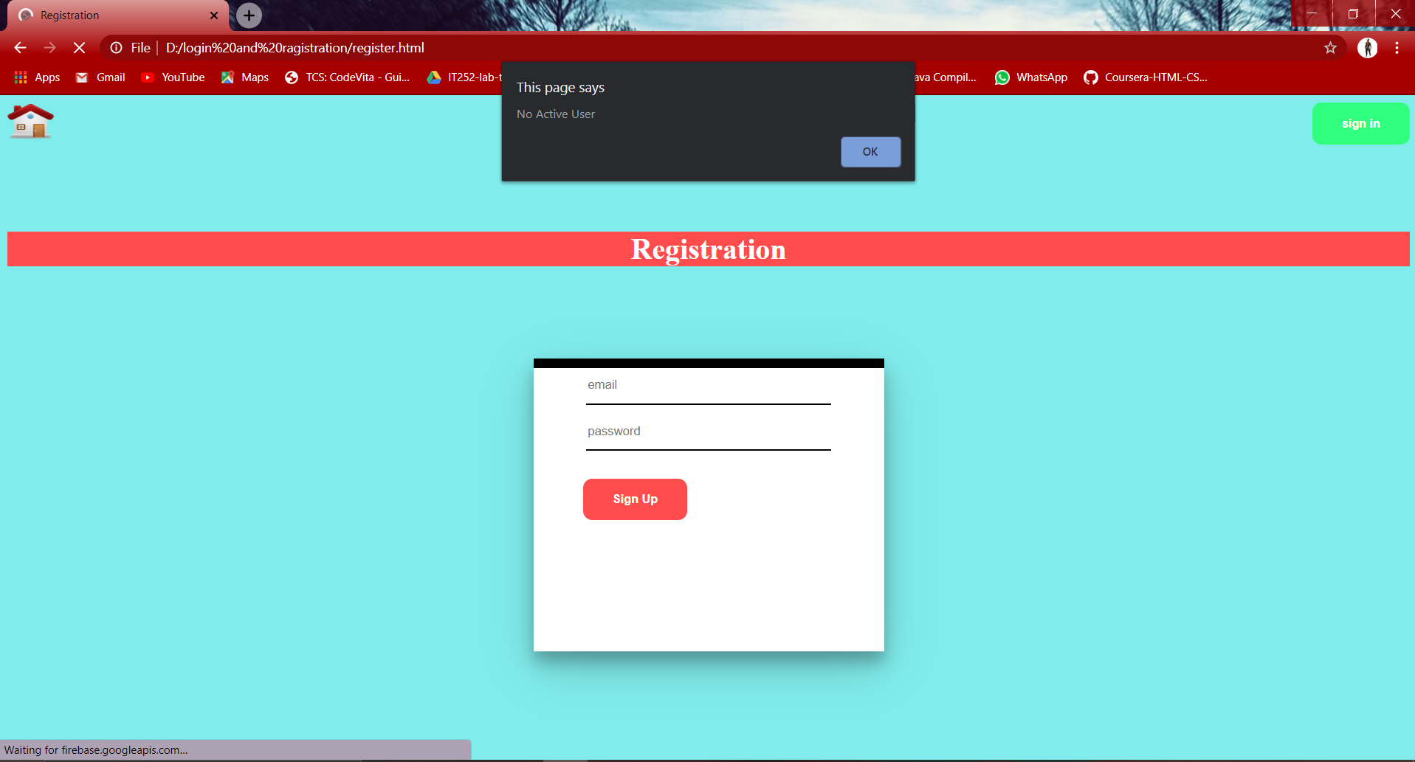
REGISTRATION PAGE:-

Slide 4
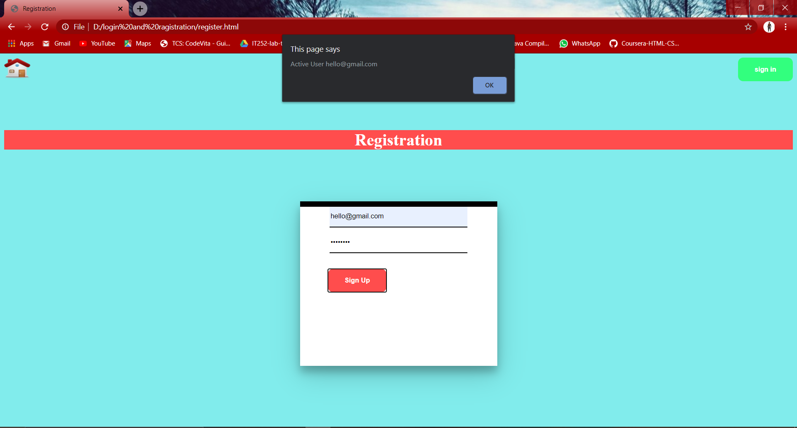
RAGISTRATION-SUCCESSFULLY:-

Slide 5
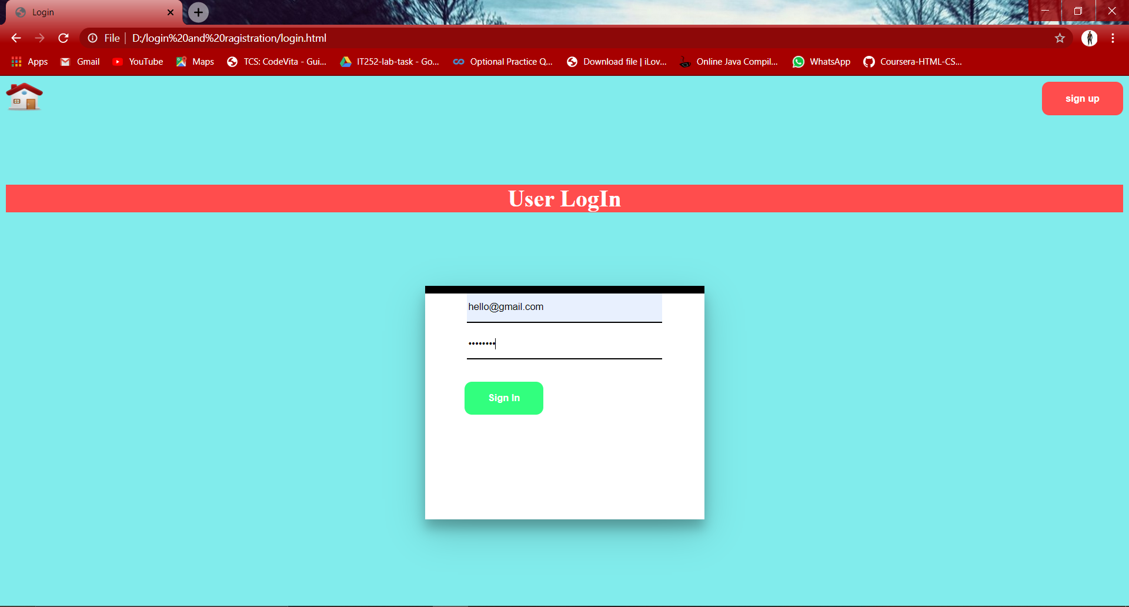
LOGIN PAGE :-

Slide 6
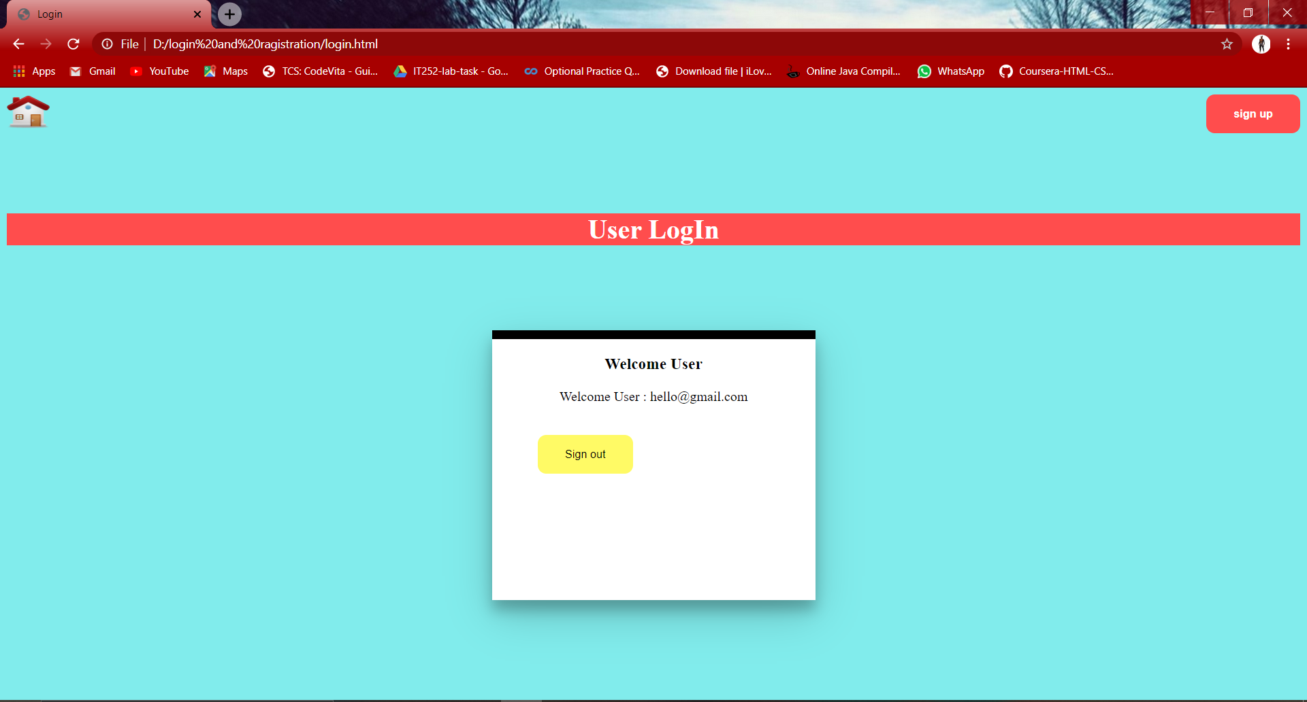
LOGIN-SUCCESSFULLY:-

Slide 7
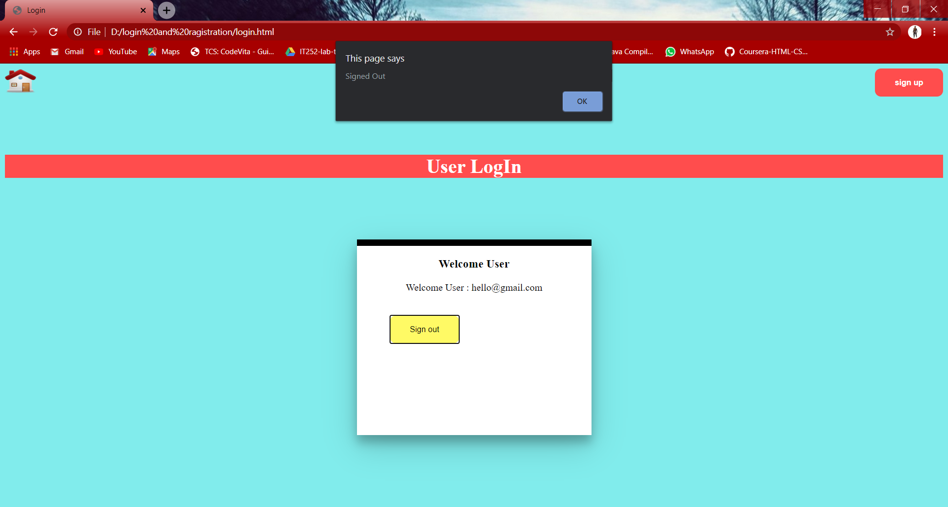
LOGOUT PAGE:

